Slide 1
2024 NOAH Whole Person Care
Screening for Health-Related Social Needs (HRSN) Update

Slide 2
What is Health Related Social Needs (HRSN)?
Health Related Social Needs was formally known as Social Determinants of Health
Health-related social needs: Social and economic needs that individuals experience that affect their ability to maintain their health and well-being. They put individuals at risk for worse health outcomes and increased health care use. HRSN refers to individual-level factors such as financial instability, lack of access to healthy food, lack of access to affordable and stable housing and utilities, lack of access to health care, and lack of access to transportation. (Adapted from HHS)

Slide 3
Why is this important?
Us:
NOAH’S Whole Person Care approach is focused on ensuring that our patients have quality health care and factors that impact care are access to food, transportation, etc. If we don’t focus in those items too, other health conditions cannot be improved.
We can prioritize care and resources based on the screening outcome
Our patients :
Improved health outcomes
Access to resources by our Community Health Workers
Control of their health

Slide 4
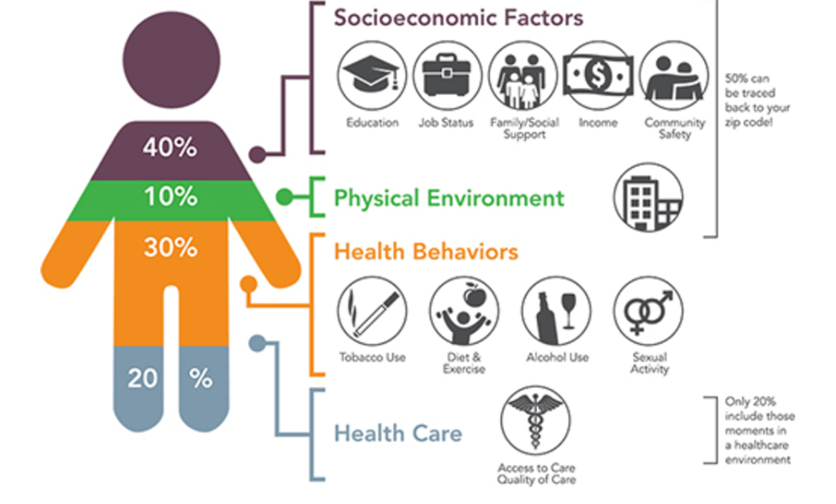
What % of someone’s health is attributed to HRSN?
80%

Slide 5
How will we screen for HRSN?
Use the PRAPARE screening available in EPIC
Go live November 1, 2024
Reach out to your leader for specific workflow guidelines

Slide 6
Who will get screened for HRSN?
New Patients Nov & Dec 2024
All patients at least once a year or as clinically necessary in 2025

Slide 7
Who do I reach out for more information?
Dora Correal
dncorreal@noahhelps.org
Director Community Access
Kerry Nickerson
knickerson@noahhelps.org
Director of Nursing and Quality

